Slide 1
AVL Tree

Slide 2
Definition
AVL Tree can be defined as height balanced binary search tree in which each node is associated with a balance factor which is calculated by subtracting the height of its right sub-tree from that of its left sub-tree.
Tree is said to be balanced if balance factor of each node is in between -1 to 1, otherwise, the tree will be unbalanced and need to be balanced.
Balance Factor (k) = height (left(k)) - height (right(k))

Slide 3
f balance factor of any node is 1, which means that the left sub-tree is one level higher than the right sub-tree.
If the balance factor of any node is 0, it means that the left sub-tree and right sub-tree contain equal height.
If the balance factor of any node is -1, it means that the left sub-tree is one level lower than the right sub-tree.

Slide 4
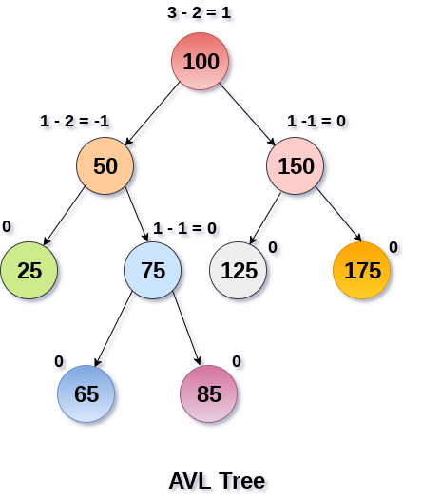
Continue . . .
An AVL tree is given in the following figure. We can see that, balance factor associated with each node is in between -1 and +1. therefore, it is an example of AVL tree.

Slide 5
Complexity
Algorithm | Average case | Worst case
Space | o(n) | o(n)
Search | o(log n) | o(log n)
Insert | o(log n) | o(log n)
Delete | o(log n) | o(log n)

Slide 6
AVL Rotations
We perform rotation in AVL tree only in case if Balance Factor is other than -1, 0, and 1. There are basically four types of rotations which are as follows:
L L rotation: Inserted node is in the left subtree of left subtree of A
R R rotation : Inserted node is in the right subtree of right subtree of A
L R rotation : Inserted node is in the right subtree of left subtree of A
R L rotation : Inserted node is in the left subtree of right subtree of A
Where node A is the node whose balance Factor is other than -1, 0, 1.

Slide 7
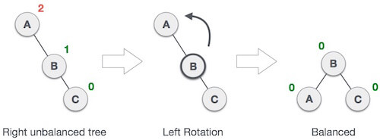
RR Rotation
When BST becomes unbalanced, due to a node is inserted into the right subtree of the right subtree of A, then we perform RR rotation, RR rotation is an anticlockwise rotation, which is applied on the edge below a node having balance factor -2
In above example, node A has balance factor -2 because a node C is inserted in the right subtree of A right subtree. We perform the RR rotation on the edge below A.

Slide 8
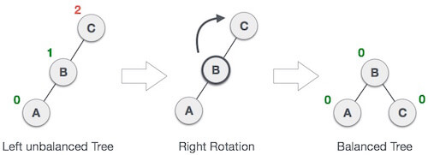
LL Rotation
When BST becomes unbalanced, due to a node is inserted into the left subtree of the left subtree of C, then we perform LL rotation, LL rotation is clockwise rotation, which is applied on the edge below a node having balance factor 2.
In above example, node C has balance factor 2 because a node A is inserted in the left subtree of C left subtree. We perform the LL rotation on the edge below A.

Slide 9
LR Rotation
Double rotations are bit tougher than single rotation which has already explained above. LR rotation = RR rotation + LL rotation, i.e., first RR rotation is performed on subtree and then LL rotation is performed on full tree, by full tree we mean the first node from the path of inserted node whose balance factor is other than -1, 0, or 1.

Slide 10


Slide 11


Slide 12
RL Rotation
As already discussed, that double rotations are bit tougher than single rotation which has already explained above. R L rotation = LL rotation + RR rotation, i.e., first LL rotation is performed on subtree and then RR rotation is performed on full tree, by full tree we mean the first node from the path of inserted node whose balance factor is other than -1, 0, or 1.

Slide 13


Slide 14


Slide 15
B Tree
B Tree is a specialized m-way tree that can be widely used for disk access. A B-Tree of order m can have at most m-1 keys and m children. One of the main reason of using B tree is its capability to store large number of keys in a single node and large key values by keeping the height of the tree relatively small.

Slide 16
B Tree . . .
A B tree of order m contains all the properties of an M way tree. In addition, it contains the following properties.
Every node in a B-Tree contains at most m children.
Every node in a B-Tree except the root node and the leaf node contain at least m/2 children.
The root nodes must have at least 2 nodes.
All leaf nodes must be at the same level.
It is not necessary that, all the nodes contain the same number of children but, each node must have m/2 number of nodes.
It is not necessary that, all the nodes contain the same number of children but, each node must have m/2 number of nodes.

Slide 17
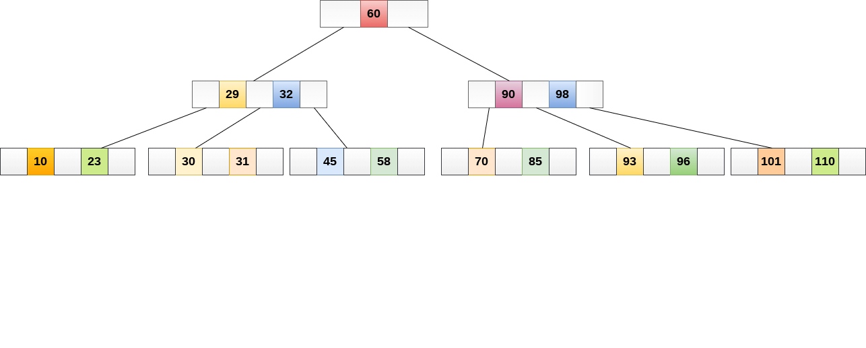
A B tree of order 4 is shown in the following image.
While performing some operations on B Tree, any property of B Tree may violate such as number of minimum children a node can have. To maintain the properties of B Tree, the tree may split or join.

Slide 18
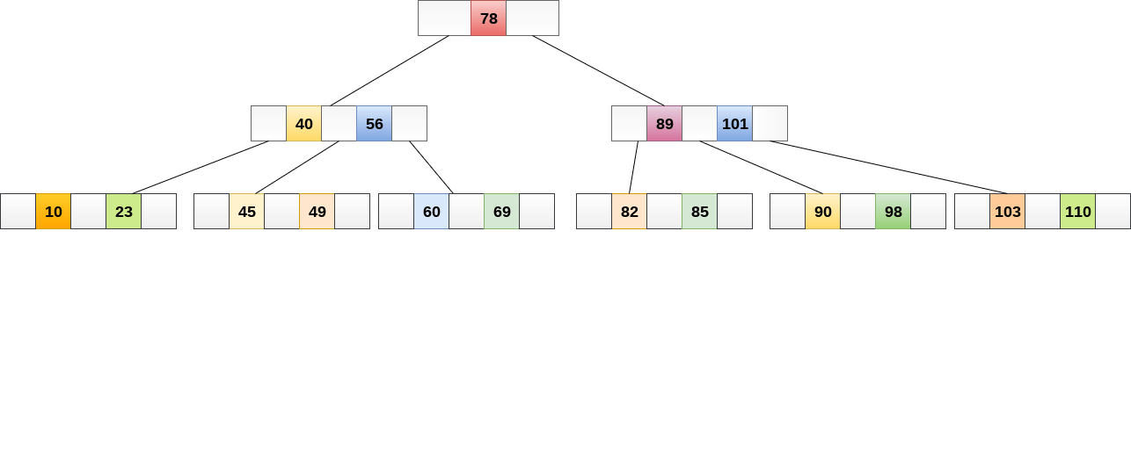
Operations
Searching :
Searching in B Trees is similar to that in Binary search tree. For example, if we search for an item 49 in the following B Tree. The process will something like following :
Compare item 49 with root node 78. since 49 < 78 hence, move to its left sub-tree.
Since, 40<49<56, traverse right sub-tree of 40.
49>45, move to right. Compare 49.
match found, return.

Slide 19
Inserting
Insertions are done at the leaf node level. The following algorithm needs to be followed in order to insert an item into B Tree.
Traverse the B Tree in order to find the appropriate leaf node at which the node can be inserted.
If the leaf node contain less than m-1 keys then insert the element in the increasing order.
Else, if the leaf node contains m-1 keys, then follow the following steps.
Insert the new element in the increasing order of elements.
Split the node into the two nodes at the median.
Push the median element upto its parent node.
If the parent node also contain m-1 number of keys, then split it too by following the same steps.

Slide 20
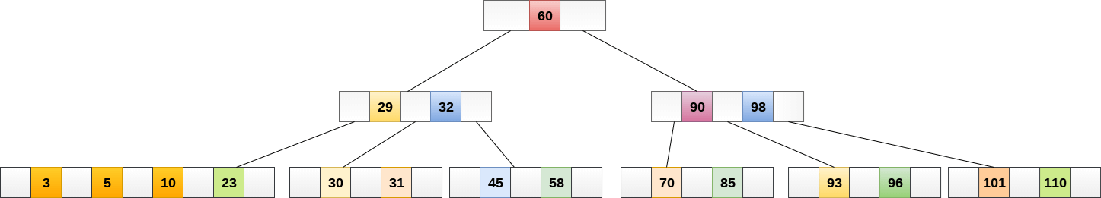
Insert the node 8 into the B Tree of order 5 shown in the following image.
8 will be inserted to the right of 5, therefore insert 8.

Slide 21
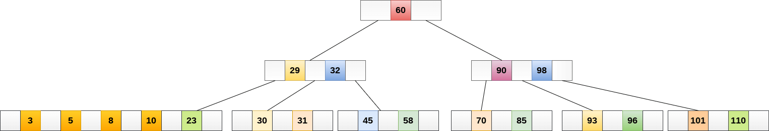
The node, now contain 5 keys which is greater than (5 -1 = 4 ) keys. Therefore split the node from the median i.e. 8 and push it up to its parent node shown as follows.

Slide 22
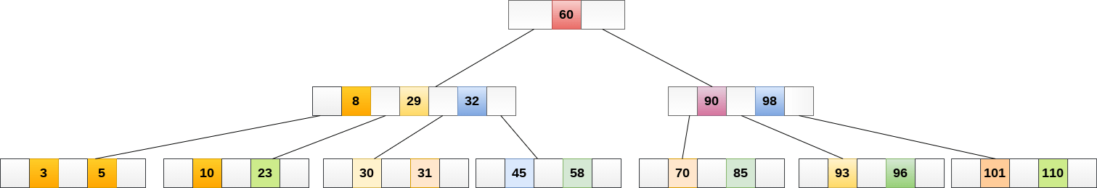

Slide 23
Deletion
Deletion is also performed at the leaf nodes. The node which is to be deleted can either be a leaf node or an internal node. Following algorithm needs to be followed in order to delete a node from a B tree.
Locate the leaf node.
If there are more than m/2 keys in the leaf node then delete the desired key from the node.
If the leaf node doesn't contain m/2 keys then complete the keys by taking the element from eight or left sibling.
If the left sibling contains more than m/2 elements then push its largest element up to its parent and move the intervening element down to the node where the key is deleted.
If the right sibling contains more than m/2 elements then push its smallest element up to the parent and move intervening element down to the node where the key is deleted.
If neither of the sibling contain more than m/2 elements then create a new leaf node by joining two leaf nodes and the intervening element of the parent node.
If parent is left with less than m/2 nodes then, apply the above process on the parent too.

Slide 24

Example
Delete the node 53 from the B Tree of order 5 shown in the following figure.

Slide 25
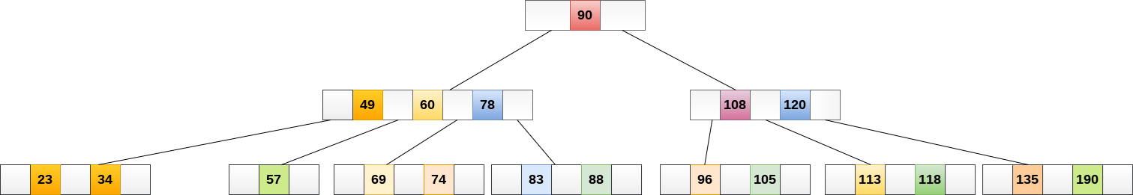
53 is present in the right child of element 49. Delete it.
Now, 57 is the only element which is left in the node, the minimum number of elements that must be present in a B tree of order 5, is 2. it is less than that, the elements in its left and right sub-tree are also not sufficient therefore, merge it with the left sibling and intervening element of parent i.e. 49.

Slide 26
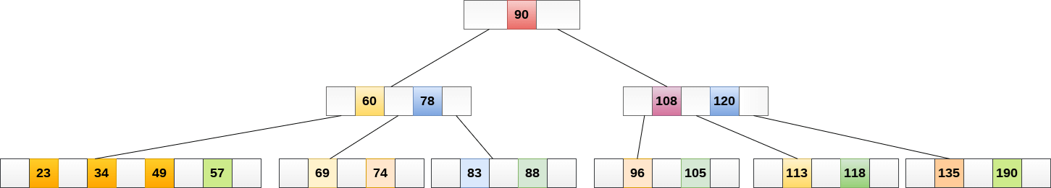
The final B tree is shown as follows.

Slide 27
Application of B tree
B tree is used to index the data and provides fast access to the actual data stored on the disks since, the access to value stored in a large database that is stored on a disk is a very time consuming process.
Searching an un-indexed and unsorted database containing n key values needs O(n) running time in worst case. However, if we use B Tree to index this database, it will be searched in O(log n) time in worst case.

Slide 28
2-3 Trees
2-3 trees are the data structure same as trees, but it has some different properties like any node can have either single value or double value. So, there are two types of nodes in 2-3 trees:
Single valued
If a node is single-valued then it has two children. Left children will contain values less than parent value, and right children will contain values greater than parent value.
Double valued
If a node has two values then it will have three children. Left children will contain values lesser than the left parent value, and middle children will contain values greater than the left parent value but less than the right parent value. Right children will contain a value greater than the right parent's value. Since, each node has either two children or three children, that's why it is called 2-3 trees. It is a height-balanced tree, and the reason is all the leaf nodes will be at the same level.

Slide 29
Search
Case 1:
If the current node is single-valued and the value is lesser than the node's value, then call the recursive function for the left child. Else, call the recursive function for the right child.

Slide 30
Search
Case 2:
If the current node is double valued, and if the value is lesser than the left value, then call the recursive function for the left child. If the target element is greater than the current node's left value and lesser than the current node's right value, then call the recursive function for middle children. Else, call the recursive for the right child.

Slide 31
Base case:
As we know, the recursion base case is the most important condition which helps to terminate the recursive calls. If the current node is null, then we will return false, or if the current node's value is equal to the target element, then we will return true.

Slide 32
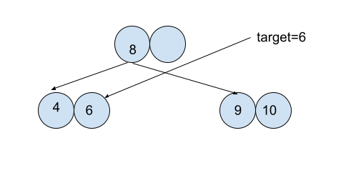
Insertion
If we want to insert any element in the tree, then we will find its correct position, and then we will insert it. We can have three cases in the insertion operation:
Case1:
Suppose the node at which we want to put the element contains a single value. In this case, we will simply insert the element.
For example:

Slide 33
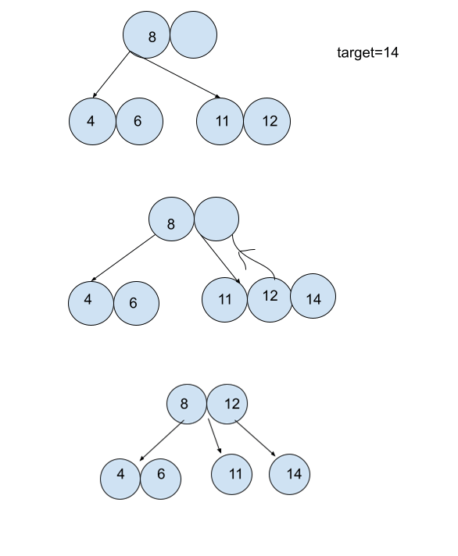
Case2:
If the node at which we want to insert the target element contains the double value and its parent is single-valued, then we will put the element at the node, and the middle value of the node will be shifted to its parent. And the current node will be split into two separate nodes.

Slide 34
Case 3:
If the node at which we want to insert is a double-valued node and its parent is also a double-valued node. We will shift the middle element to the parent node and split the current node. Now its parent has three values, so it will also shift its middle element to its parent node and split the parent node into two separate nodes.

Slide 35
Deletion
A value is removed after being replaced by its in-order successor in order to be deleted. Two nodes must be combined together if a node has less than one data value remaining. After removing a value, a node is merged with another if it becomes empty.

